Slide 1
HighTech Group 6

Slide 2
Team Members and their responsibilities
Theoveshan Naidu : UX designer and unit testing
Alexandros Petrou : GitHub Management and developing the app
Janaki Patil : Implement functionalities for the admin portal and user portal.
Tristan Sander-hughes : Implement security features and handle documentation
Zi Xin Zhang : ZenHub Management and developing the app

Slide 3




Our System
Sends email with
details in
certain format
New case is
handled by
Performs task
Login
Generate new case report based on details sent by client
Insurance company or 24 Fix Company
24 Fix agent
Agent sends plumber on site
Login
Scan Barcode
Enter geyser details
Upload installation/repair images of the geyser
Submit
Performs task
1 Cases that are marked as completed are shown.
2. Agent closes the case.

Slide 4



Extra functionality to our system
Allows Agent to add/delete an employee.
User portal for getting customers feedback.
View statistics and generate reports.

Slide 5
Impressive features of our system
AutoFill functionality
Website-app synchronisation
Validating the user at every phase.
The mobile app itself.

Slide 6
Deployment
Diagram

Slide 7
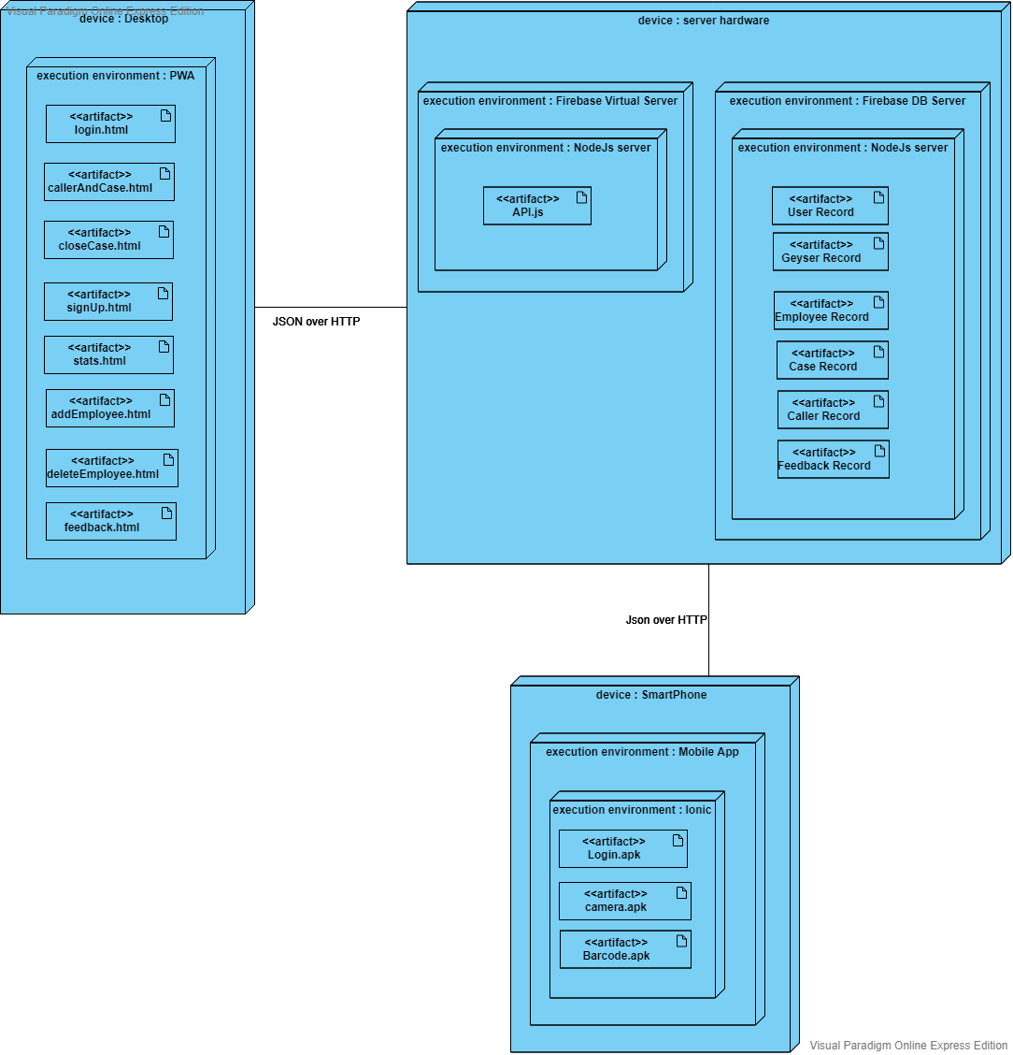
Deployment Diagram

Slide 8
Task Pending
Search functionality : Search number of cases for specific month
Mining user feedbacks.
integrating following files with api:
=> Sign up

Slide 9

Thank you

